Slide 1
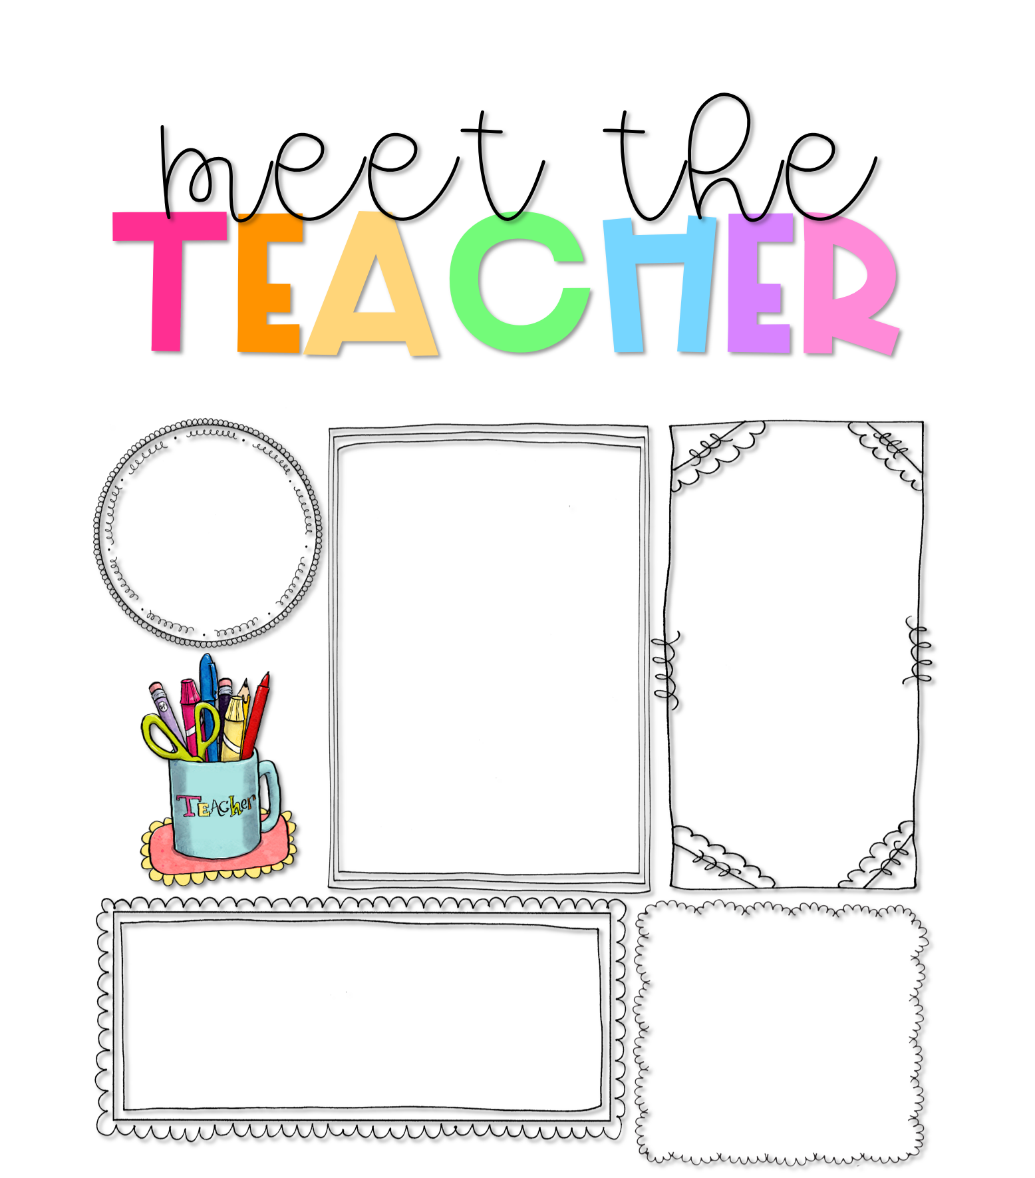
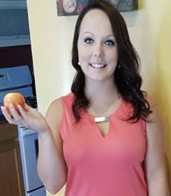
Ms. Wallace
Scratch here!
About Me
Welcome to Kindergarten!
I am pleased to welcome you to the 2021/2022 school year! I am so excited to have your child as my student! My goal is to encourage them to be the best person they can be and support your child in every way. I promise to do my best to help them learn and grow both inside and outside the classroom. Here at LECC, we are committed to make learning safe, meaningful, and fun! Kindergarten is such a great year with so many wonderful milestones to celebrate. There will be new friends, adventures, and learning! I am committed to creating a classroom environment where your child is safe, valued, and integral part of our family of learners. Welcome to LECC!
Hello! I am Ms. Sam Wallace. This will be my third year teaching kindergarten here at LECC. I currently live in Woodland with my family and our two dogs. We like to spend a lot of time outside, riding dirt bikes, and camping. In my free time I train and perform in powerlifting competitions.
For my education, I attended Grand Valley State University where I received my Bachelors in Exercise Science. Then I became a substitute teacher for Lakewood and went back to school to obtain my K-5 elementary teaching certification. Kindergarten is my passion, so I’m fortunate to do what I love every day!
Contact Me
My Favorites
I welcome and value parent involvement throughout the year. I would love to hear from you, and you are welcome to contact me with any questions, comments, or concerns you may have.
Food:
Chinese
Drink:
Sprite
616-374-8043 x2122
Seesaw
Candy:
Nerds Rope
616-577-0900
Hobby:
Powerlifting
samanthawallace@
lakewoodps.org
Fall
Season:
Subject:
Reading

